Slide 1

ASTA’s Priorities and International Program

Slide 2






We focus on six priority countries/regions
Argentina
Brazil
Mexico
SAA
China
Global

Slide 3



Argentina
Argentina Intellectual
Property Rights
Outreach Project

Slide 4






Brazil
Norm 36
Research- seed movement
Brazil Embassy in DC

Slide 5





Mexico
Untreated Seed Protocol
Harmonized testing methods
Mexico Embassy in DC

Slide 6

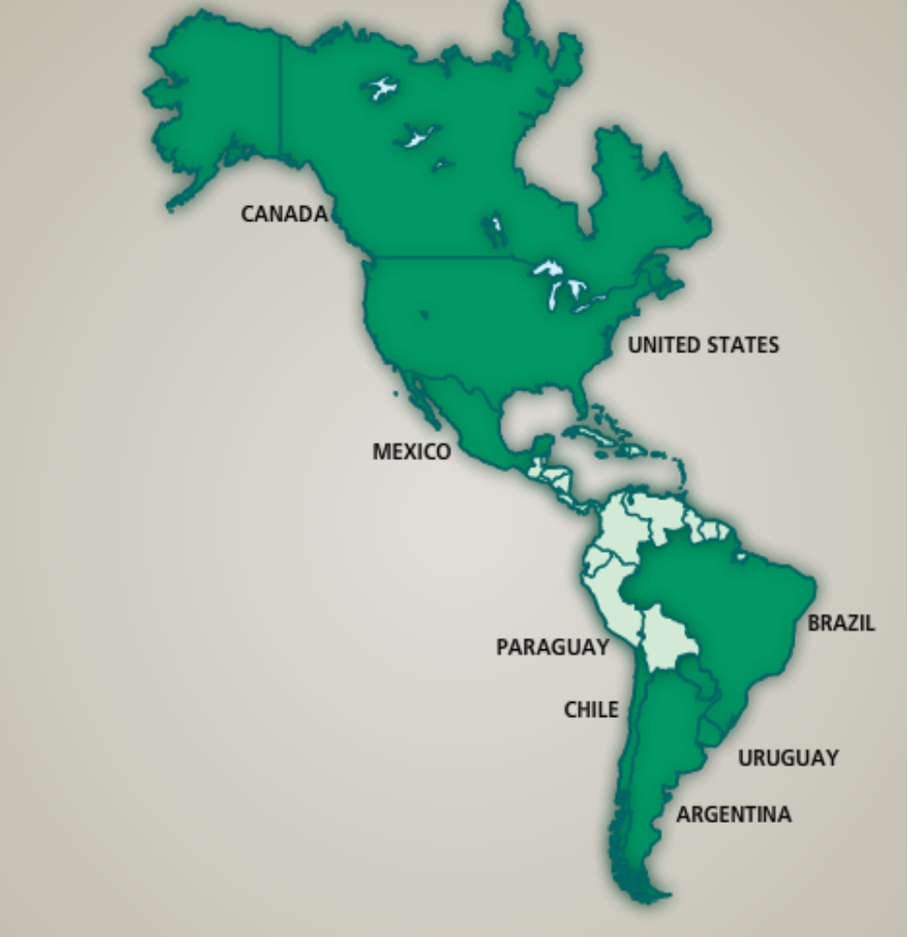
Seed Association of the Americas
Working Committees
IP
Biotechnology
Seed Treatment
Phytosanitary

Slide 7




China
MOU + Steering committee
IP
Seed movement
Phytosanitary
Agriculture and Food Partnership
US Embassy in Bejing

Slide 8



Global
Market Research
Ukraine Seed Market Outlook to 2018
Russia Seed Industry Outlook to 2018
Bangladesh Seed Laws and Regulations –
A Chronological Summary
Vietnam releases new guidance on Pest Risk Analysis
Cuba
African Seed Trade Association
APSA

Slide 9
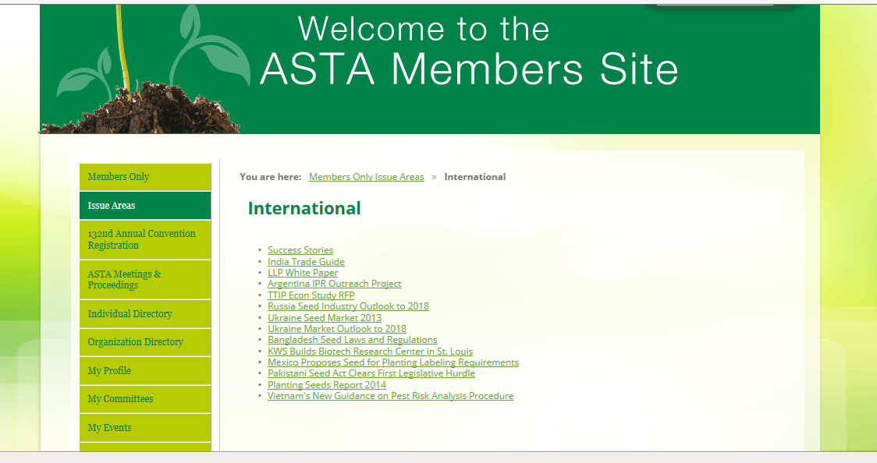
Member’s-only area in ASTA’s web page

Slide 10


Here we report what we do

Slide 11

Other services ASTA provides to members:
PRAs
Phytosanitary database
Trade Guides
Embassies Fly-ins
Trade leads

Slide 12
ASTA’s Priorities and International Program
Where our 2015 budget come from?
FMD + MAP: $550,000
2014 Industry In-Kind Donations:
$8,652,000 (Combined MAP and FMD)

